Slide 1
Big Data Analytics and Mining
Junming Shao

Slide 2
6.1 哈希技术
HASHING

Slide 3

为什么我们需要哈希技术?
Wal-Mart: 267 million items/day; 4PB data warehouse
Sloan Digital Sky Survey: New Mexico telescope captures 200 GB image data/day
大数据挖掘面临的一些问题:
高维诅咒问题
存储问题
检索速度问题

Slide 4
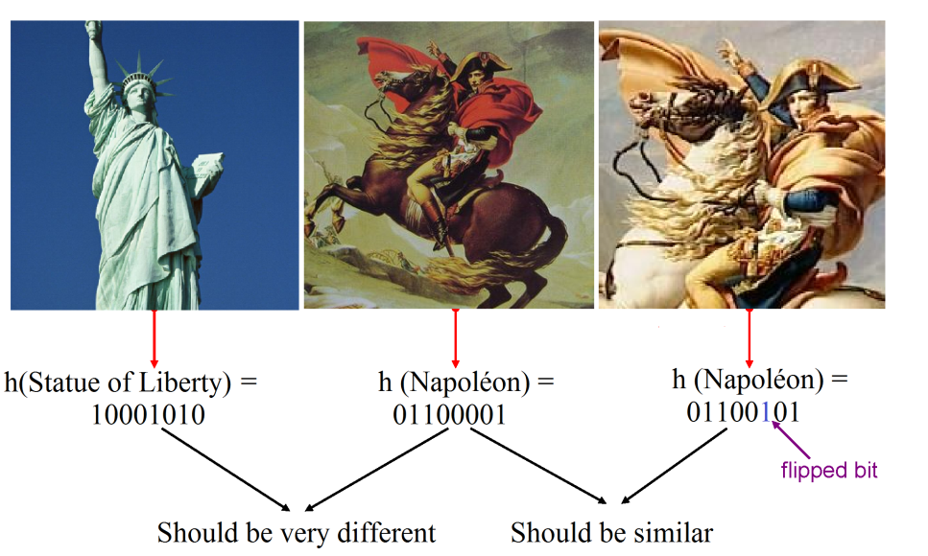
Example 1. 信息检索

Slide 5
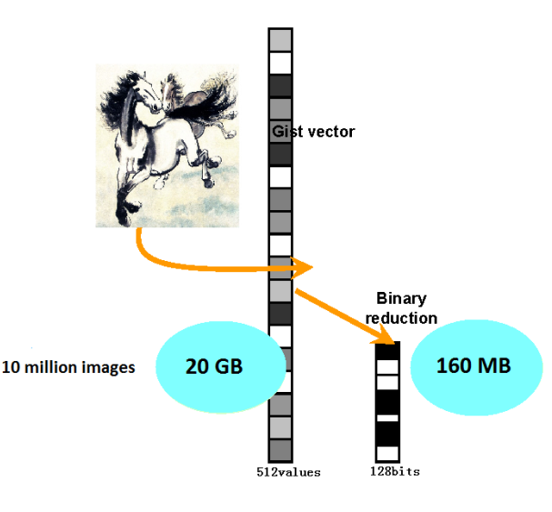
Example 2. 存储

Slide 6
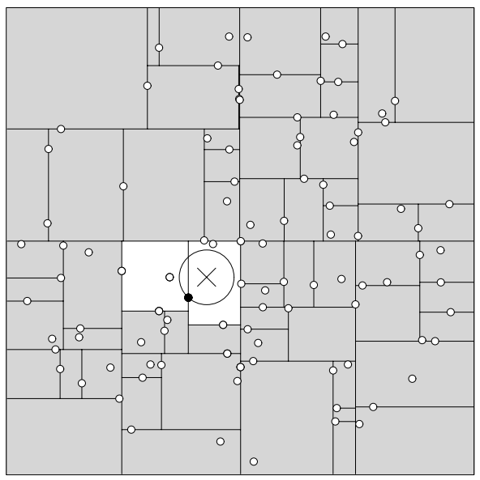
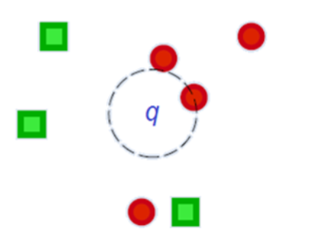
Example 3. 最邻近点检索
给定一个检索点，如何在数据库中找出最邻近的点呢？
KD-TREE
KD-tree 不能处理高维数据。

Slide 7
局部敏感哈希（LSH）

Slide 8
Locality-Sensitive Hashing
Find Similar Items

Slide 9
三个关键技术
Introduction
Shingling : convert documents, emails, etc., to sets.
Minhashing : convert large sets to short signatures, while preserving similarity.
Locality-sensitive hashing : focus on pairs of signatures likely to be similar.

Slide 10
整体框架
Introduction
Candidate
pairs :
those pairs
of signatures
that we need
to test for
similarity.
Shingling
Minhash-
ing
Locality-
sensitive
Hashing
Document
The set
of strings
of length k
that appear
in the document
Signatures :
short integer
vectors that
represent the
sets, and
reflect their
similarity

Slide 11
Shingles技术
Shingling
一个文档的 k -shingle (或 k -gram) 是指连续K个字符一起出现的序列。
Example: k=2; doc = abcab. Set of 2-shingles = {ab, bc, ca}.
Option: regard shingles as a bag, and count ab twice.
一个文档可以通过k-shingles来很好表示.

Slide 12
Big Data Analytics and Mining
Junming Shao

Slide 14
Min-Hashing
（最小哈希）

Slide 15
最小哈希的步骤
Minhashing
计算签名矩阵
通过签名矩阵寻找相似的签名
检测签名相似的是否真的相似（可选）.

Slide 16
签名矩阵
Minhashing
Key idea: “hash” each column C to a small signature Sig (C), such that:
Sig (C) is small enough that we can fit a signature in main memory for each column.
Sim (C₁, C₂) is the same as the “similarity” of Sig (C₁) and Sig (C₂).

Slide 17
四种状态
Minhashing
Given columns C₁ and C₂, rows may be classified as:
C₁ C₂
a 1 1
b 1 0
c 0 1
d 0 0
Also, a = # rows of type a , etc.
Note: Sim (C₁, C₂) = a /(a +b +c ).

Slide 18
最小哈希 Min-Hash
Minhashing
Imagine the rows permuted randomly.
Define “hash” function h (C ) = the number of the first (in the permuted order) row in which column C has 1.
Use several (e.g., 100) independent hash functions to create a signature.

Slide 19
例子: 最小哈希
6
7
1
0
1
1
0
3
6
2
0
0
1
1
3
1
1
2
1
5
3
1
0
0
0
2
2
1
3
7
4
4
0
1
0
1
2
3
5
0
0
0
1
1
5
3
2
5
2
6
1
1
0
0
4
1
7
0
0
1
0
Signature Matrix
Permutation
Input Matrix

Slide 20
Surprising Property
Minhashing
The probability (over all permutations of the rows) that h (C₁) = h (C₂) is the same as Sim (C₁, C₂).
Both are a /(a +b +c )!
Why?
Look down the permuted columns C₁ and C₂ until we see a 1.
If it’s a type-a row, then h (C₁) = h (C₂). If a type-b or type-c row, then not.

Slide 21
最小哈希签名
Minhashing
Pick (say) 100 random permutations of the rows.
Think of Sig (C) as a column vector.
Let Sig (C)[i] =
according to the i th permutation, the number of the first row that has a 1 in column C.

Slide 22
最小哈希– 例子
0
1
1
0
Columns 1 & 2:
Jaccard similarity 1/4
Signature similarity 1/3
0
0
1
1
3
1
1
2
1
0
0
0
2
2
1
3
Columns 2 & 3:
Jaccard similarity 1/5
Signature similarity 1/3
0
1
0
1
0
0
0
1
1
5
3
2
1
1
0
0
Columns 3 & 4:
Jaccard similarity 1/5
Signature similarity 0
0
0
1
0
Signature Matrix
Input Matrix

Slide 23
具体实现
Minhashing
Initialize M(i,c) to ∞ for all i and c
for each row r
for each column c
if c has 1 in row r
for each hash function h_{i} do
if h_{i} (r ) is a smaller value than M (i, c ) then
M (i, c ) := h_{i} (r );

Slide 24
Example
Minhashing
Sig1 Sig2
Row C1 C2
1 1 0
2 0 1
3 1 1
4 1 0
5 0 1
h(1) = 1 1 -
g(1) = 3 3 -
h(2) = 2 1 2
g(2) = 0 3 0
h(3) = 3 1 2
g(3) = 2 2 0
h(x) = x mod 5
g(x) = 2x+1 mod 5
h(4) = 4 1 2
g(4) = 4 2 0
h(5) = 0 1 0
g(5) = 1 2 0

Slide 25
局部敏感哈希

Slide 26
相似文档检索
Locality-Sensitive Hashing
Suppose we have, in main memory, data representing a large number of objects.
May be the objects themselves .
May be signatures as in minhashing.
We want to compare each to each, finding those pairs that are sufficiently similar.

Slide 27
枚举所有对是非常困难的
Locality-Sensitive Hashing
While the signatures of all columns may fit in main memory, comparing the signatures of all pairs of columns is quadratic in the number of columns.
Example: 10⁶ columns implies 5*10¹¹ column-comparisons.
At 1 microsecond/comparison: 6 days.

Slide 28
Locality-Sensitive Hashing
Locality-Sensitive Hashing
General idea: Use a function f(x,y) that tells whether or not x and y is a candidate pair : a pair of elements whose similarity must be evaluated.
For minhash matrices: Hash columns to many buckets, and make elements of the same bucket candidate pairs.

Slide 29
Candidate Generation From Minhash Signatures
Locality-Sensitive Hashing
Pick a similarity threshold s, a fraction < 1.
A pair of columns c and d is a candidate pair if their signatures agree in at least fraction s of the rows.
I.e., M (i, c ) = M (i, d ) for at least fraction s values of i.

Slide 30
LSH
Locality-Sensitive Hashing
基本思想: hash columns of signature matrix M several times.
Arrange that (only) similar columns are likely to hash to the same bucket.
Candidate pairs are those that hash at least once to the same bucket.
Trick: divide signature rows into bands.
Each hash function based on one band.

Slide 31
Partition Into Bands
Locality-Sensitive Hashing
r rows
per band
b bands
One
signature
Matrix M

Slide 32
Partition into Bands
Locality-Sensitive Hashing
Divide matrix M into b bands of r rows.
For each band, hash its portion of each column to a hash table with k buckets.
Make k as large as possible.
Candidate column pairs are those that hash to the same bucket for ≥ 1 band.
Tune b and r to catch most similar pairs, but few dissimilar pairs.

Slide 33
Locality-Sensitive Hashing
Columns 2 and 6
are probably identical.
Buckets
Columns 6 and 7 are
surely different.
Matrix M
r rows
b bands

Slide 34
Example: Bands的影响
Locality-Sensitive Hashing
Suppose 100,000 columns.
Signatures of 100 integers.
Therefore, signatures take 40Mb.
Want all 80%-similar pairs.
5,000,000,000 pairs of signatures can take a while to compare.
Choose 20 bands of 5 integers/band.

Slide 35
假设C₁, C₂ 80% 相似
Locality-Sensitive Hashing
Probability C₁, C₂ identical in one particular band: (0.8)⁵ = 0.328.
Probability C₁, C₂ are not similar in any of the 20 bands: (1-0.328)²⁰ = .00035 .
i.e., about 1/3000th of the 80%-similar column pairs are false negatives.

Slide 36
假设C₁, C₂ 30% 相似
Locality-Sensitive Hashing
Probability C₁, C₂ identical in any one particular band: (0.3)⁵ = 0.00243 .
Probability C₁, C₂ identical in ≥ 1 of 20 bands: ≤ 20 * 0.00243 = 0.0486 .
In other words, approximately 4.86% pairs of docs with similarity 30% end up becoming candidate pairs
False positives

Slide 37
What b Bands of r Rows Gives You
Locality-Sensitive Hashing
At least
one band
identical
No bands
identical
(
s ^{r}
t ~ (1/b)^{1/r}
1 -
1 -
)^{b}
Probability
of sharing
a bucket
Some row
of a band
unequal
All rows
of a band
are equal
t
Similarity s of two sets

Slide 38
Example: b = 20; r = 5
Locality-Sensitive Hashing
s | 1-(1-s^{r})^{b}
.2 | .006
.3 | .047
.4 | .186
.5 | .470
.6 | .802
.7 | .975
.8 | .9996

Slide 39
2. 数据流挖掘

Slide 40
Outline
What is data stream?
What is Concept Drift?
Data stream classification
Data stream clustering

Slide 41

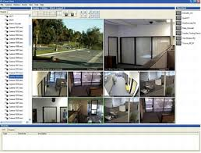


Internet
Surveillance
Spam Filtering
DATA STREAM
Network Intrusion
Industry
Mobile
Smart Phone
Sensor
*Note: some pictures derived from internet

Slide 42
Potential Applications
Telecommunication calling records
Business: credit card transaction flows
Network monitoring and traffic engineering
Financial market: stock exchange
Engineering & industrial processes: power supply & manufacturing
Sensor, monitoring & surveillance: video streams, RFIDs
Security monitoring
Web logs and Web page click streams

Slide 43
What is data stream?
A data stream is a massive sequence of data objects which have some unique features:
One by One
Potentially Unbounded
Concept Drift
data4
data3
data2
data1
Data mining system
Data stream

Slide 44
Challenges
Data Stream: (a) Infinite Length (b) Evolving Nature
Single Pass Handling
Memory Limitation
Low Time Complexity
Concept Drift

Slide 45
What is concept drift？
In predictive analytics and machine learning, the concept drift means that the statistical properties of the target variable, which the model is trying to predict, change over time in unforeseen ways.
In a word, the probability distribution changes.
Change in P(C)
Change in P(X)
Change in P(C|X)

Slide 46
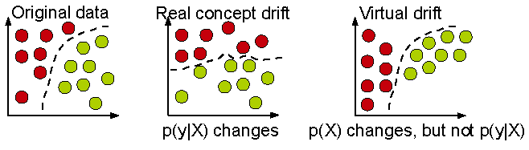
Real concept drift vs. Virtual concept drift

Slide 47
Example: Concept-Drift
Current hyperplane
Previous hyperplane
A data chunk
Instances victim of concept-drift
Negative instance
Positive instance
Notes:
Suppose we divide the data stream into equal sized chunks
This is a data chunk, where each data point is two dimensional
A hyperplane separates the data points into two classes: positive and negative
Suppose this is the next data chunk
We see that the hyperplane has shifted
As a result, some data points that were negative according to the previous hyperplane, are now positive -> this indicates concept-drift
In the next data chunk, we see again the hyperplane has shifted, and some data points changed their label
47

Slide 48
Big Data Analytics and Mining
Junming Shao

Slide 50
1、 Concept Drift Detection

Slide 51
Distribution-based detector
Monitoring the change of data distributions between two fixed or adaptive windows of data. (e.g. ADWIN)
w₁
w₂
Hard to determine window size
Learn concept drift slower
Virtual concept drift

Slide 52
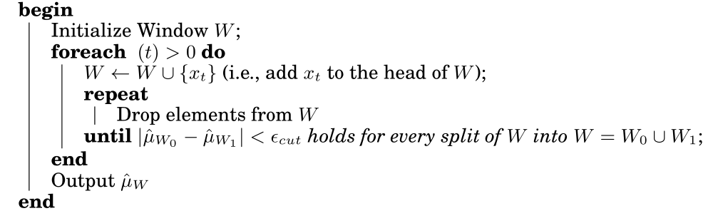
Adaptive Windowing（ADWIN）
The idea is simple: whenever two “large enough” subwindows of
W exhibit “distinct enough” averages, one can conclude that the corresponding expected values are different,and the older portion of the window is dropped.

Slide 53
Error-rate based detector
Capture concept drift based on the change of the classification performance. (i.e. comparing the current classification performance to the average historical error rate with statistical analysis.) (e.g. PHT)
Infer time-changing concept relying on performance degradation
Indirectly
Sensitive to noise
Hard to deal with gradual concept drift
Depend on learning model itself heavily

Slide 54
Drift detection method: DDM
The theory guarantees that while the class distribution of the examples is stationary , the error rate of the learning algorithm will decrease when i increases. A significant increase in the error of the algorithm, suggest a change in the class distribution, and whether is a significant increase is based on following formula.
the error-rate is the probability of observe False,
, with standard deviation given by

Slide 55
2、Data Stream Classification

Slide 56
Data stream classification
Classification: Model construction based on training sets
Typical classification methods
K-Nearest neighbor approach
Decision tree
Bayesian classification
Neural network approach
Support Vector Machines
Other methods
Are these approaches ok for data stream classification?

Slide 57
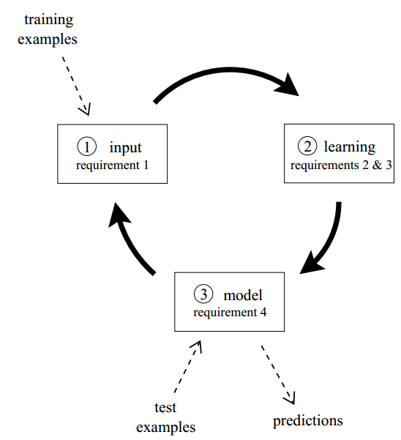
Data stream classification Circle
Process an example at a time, and inspect it only once
Be ready to predict at any point
Use a limited amount of memory
Work in a limited amount of time

Slide 58
Procedure
The algorithm is passed the next available example from the stream (requirement 1)
The algorithm processes the example, updating its data structures. It does so without exceeding the memory bounds set on it (requirement 2), and as quickly as possible (requirement 3).
The algorithm is ready to accept the next example. (requirement 4)

Slide 59
VFDT (Very Fast Decision Tree, KDD’00)
SyncStream (Shao et al., KDD’14)

Slide 60
Decision Tree Learning
One of the most effective and widely-used classification methods
Induce models in the form of decision trees
Each node contains a test on the attribute
Each branch from a node corresponds to a possible outcome of the test
Each leaf contains a class prediction
Age<30?
Yes
No
Car Type=
Sports Car?
Yes
Yes
No
No

Slide 61
Challenges
Classic decision tree learners assume all training data can be simultaneously stored in main memory
Disk-based decision tree learners repeatedly read training data from disk sequentially
Prohibitively expensive when learning complex trees
Goal: design decision tree learners that read each example at most once, and use a small constant time to process it

Slide 62
VFDT (Very Fast Decision Tree)
A decision-tree learning system based on the Hoeffding tree algorithm
In order to find the best attribute at a node, it may be sufficient to consider only a small subset of the training examples that pass through that node.
Given a stream of examples, use the first ones to choose the root attribute.
Once the root attribute is chosen, the successive examples are passed down to the corresponding leaves, and used to choose the attribute there, and so on recursively.
Use Hoeffding bound to decide how many examples are enough at each node

Slide 63
How many examples are enough?
Let G(X_{i}) be the heuristic measure used to choose test attributes (e.g. Information Gain, Gini Index)
X_{a} : the attribute with the highest attribute evaluation value after seeing n examples.
X_{b} : the attribute with the second highest split evaluation function value after seeing n examples.
Given a desired , if after seeing n examples at a node,
Hoeffding bound guarantees the true , with probability 1-.
This node can be split using X_{a}, the succeeding examples will be passed to the new leaves.
Hoeffding Bound

Slide 64
Algorithm
Calculate the information gain for the attributes and determines the best two attributes
At each node, check for the condition
If condition satisfied, create child nodes based on the test at the node
If not, stream in more examples and perform calculations till condition satisfied

Slide 65
Age<30?
Data Stream
Yes
No
Yes
Age<30?
Data Stream
Yes
No
Car Type=
Sports Car?
Yes
Yes
No
No

Slide 66
3、数据流聚类

Slide 67
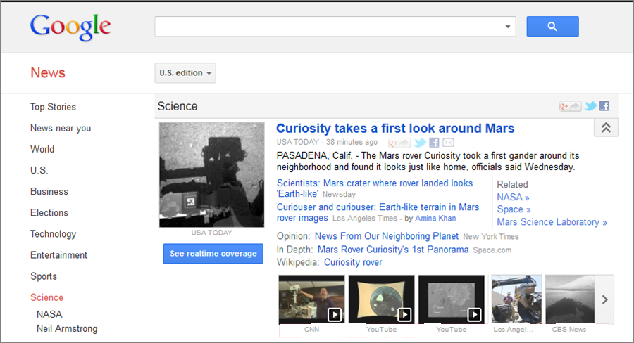
Example: Stream Clustering
Topic cluster
Article
Listings

Slide 68
Data stream clustering Framework
Online Phase
Summarize the data into memory-efficient data structures
Offline Phase
Use a clustering algorithm to find the data partition

Slide 69
Micro-Clusters
A Micro-Cluster is a set of individual data points that are close to each other and will be treated as a single unit in further offline Macro-clustering.
View of Micro-Cluster
View of Macro-Cluster

Slide 70
Stream Clustering Algorithms
Data Structures | Examples
Prototypes | Stream, Stream Lsearch
Cluster Feature | CluStream, ClusTree, DenStream, HP-Stream, Scalable k-means
Grids | D-Stream, ODAC
Coreset Tree | StreamKM++

Slide 71
Cluster Feature: CF = (N, LS, SS)
where N: # data points, LS = , SS =
Key Point: Additivity Property

Slide 72
The CluStream Framework
Micro-cluster
Statistical information about data locality
Temporal extension of the cluster-feature vector
Multi-dimensional points with time stamps
Each point contains d dimensions, i.e.,
A micro-cluster for n points is defined as a (2*d + 3) tuple
Pyramidal time frame
Decide at what moments the snapshots of the statistical information are stored away on disk

Slide 73
CluStream: Pyramidal Time Frame
Pyramidal time frame
Snapshots of a set of micro-clusters are stored following the pyramidal pattern
They are stored at differing levels of granularity depending on the recency
Snapshots are classified into different orders varying from 1 to log(T)
The i-th order snapshots occur at intervals of α^{i} where α ≥ 1
Only the last (α + 1) snapshots are stored

Slide 74
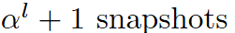
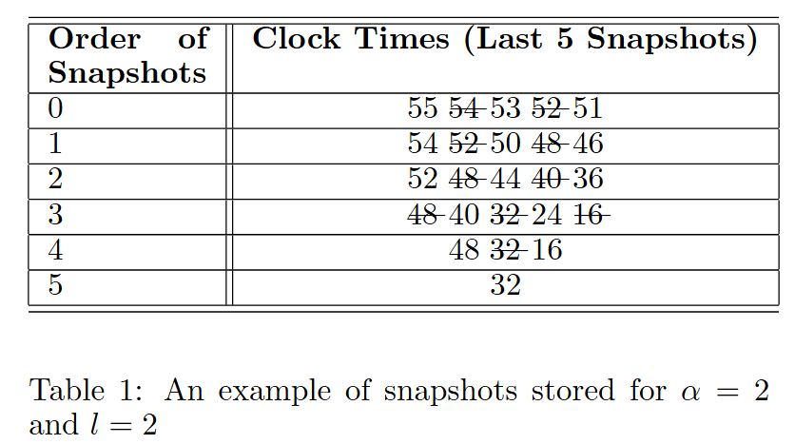

Slide 75
CluStream: Clustering On-line Streams
Online micro-cluster maintenance
Initial creation of q micro-clusters
q is usually significantly larger than the number of natural clusters
Online incremental update of micro-clusters
If new point is within max-boundary, insert into the micro-cluster
o.w., create a new cluster
May delete obsolete micro-cluster or merge two closest ones
Offline Phase: Query-based macro-clustering
Based on a user-specified time-horizon h and the number of macro-clusters k, compute macroclusters using the k-means algorithm

Slide 76
3. Hadoop/Spark

Slide 77
What is Hadoop
Hadoop is a software framework for distributed processing of large datasets across large clusters of computers
Large datasets → Terabytes or petabytes of data
Large clusters → hundreds or thousands of nodes
Hadoop is open-source implementation for Google MapReduce
Hadoop is based on a simple programming model called MapReduce
Hadoop is based on a simple data model, any data will fit

Slide 78
Design Principles of Hadoop
Need to process big data
Need to parallelize computation across thousands of nodes
Commodity hardware
Large number of low-end cheap machines working in parallel to solve a computing problem
This is in contrast to Parallel DBs
Small number of high-end expensive machines

Slide 79
Divide and Conquer
“Work”
Partition
w₁
w₂
w₃
“worker”
“worker”
“worker”
r₁
r₂
r₃
Combine
“Result”

Slide 80
It’s a bit more complex…
Fundamental issues
scheduling, data distribution, synchronization, inter-process communication, robustness, fault tolerance, …
Different programming models
Message Passing
Shared Memory
Memory
P₁
P₂
P₃
P₄
P₅
P₁
P₂
P₃
P₄
P₅
Architectural issues
Flynn’s taxonomy (SIMD, MIMD, etc.), network typology, bisection bandwidth UMA vs. NUMA, cache coherence
Different programming constructs
mutexes, conditional variables, barriers, …
masters/slaves, producers/consumers, work queues, …
Common problems
livelock, deadlock, data starvation, priority inversion…
dining philosophers, sleeping barbers, cigarette smokers, …
The reality: programmer shoulders the burden of managing concurrency…

Slide 81
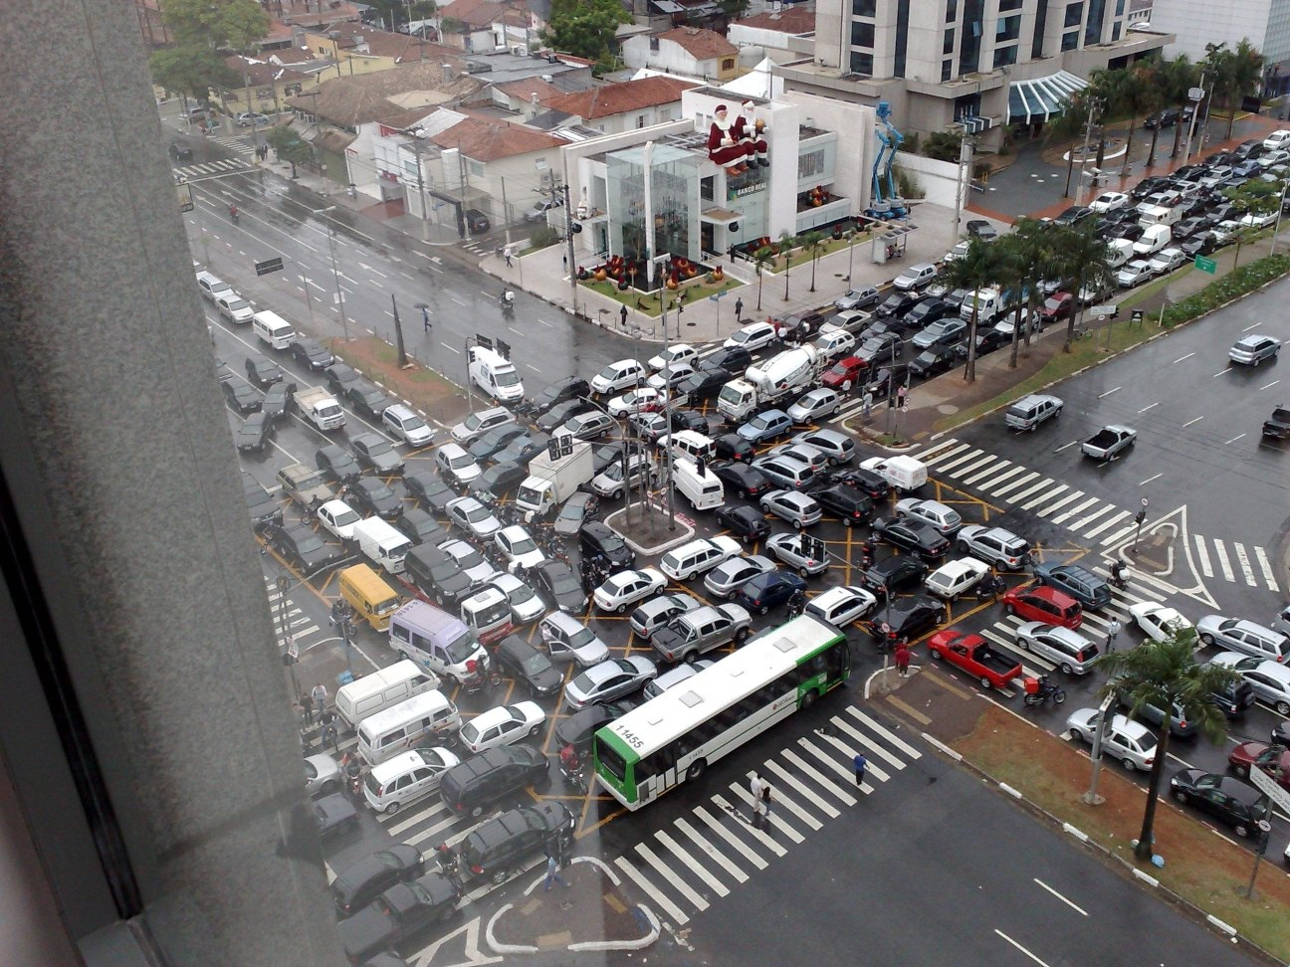
Source: Ricardo Guimarães Herrmann

Slide 82
Design Principles of Hadoop
Automatic parallelization & distribution
Hidden from the end-user
Fault tolerance and automatic recovery
Nodes/tasks will fail and will recover automatically
Clean and simple programming abstraction
Users only provide two functions “map” and “reduce”

Slide 83
Hadoop: How it Works

Slide 84
Hadoop
HBase
Pig
Hive
Chukwa
MapReduce
HDFS
Zoo
Keeper
Core
Avro
Hadoop’s stated mission (Doug Cutting interview):
Commoditize infrastructure for web-scale,
data-intensive applications

Slide 85
Hadoop
HBase
Pig
Hive
Chukwa
Filesystems and I/O:
Abstraction APIs
RPC / Persistence
MapReduce
HDFS
Zoo
Keeper
Core
Avro

Slide 86
Hadoop
HBase
Pig
Hive
Chukwa
Cross-language serialization:
RPC / persistence
~ Google ProtoBuf / FB Thrift
MapReduce
HDFS
Zoo
Keeper
Core
Avro

Slide 87
Hadoop
Distributed execution (batch)
Programming model
Scalability / fault-tolerance
HBase
Pig
Hive
Chukwa
MapReduce
HDFS
Zoo
Keeper
Core
Avro

Slide 88
Hadoop
Distributed storage (read-opt.)
Replication / scalability
~ Google filesystem (GFS)
HBase
Pig
Hive
Chukwa
MapReduce
HDFS
Zoo
Keeper
Core
Avro

Slide 89
Hadoop
Coordination service
Locking / configuration
~ Google Chubby
HBase
Pig
Hive
Chukwa
MapReduce
HDFS
Zoo
Keeper
Core
Avro

Slide 90
Hadoop
HBase
Pig
Hive
Chukwa
MapReduce
HDFS
Zoo
Keeper
Column-oriented, sparse store
Batch & random access
~ Google BigTable
Core
Avro

Slide 91
Hadoop
HBase
Pig
Hive
Chukwa
MapReduce
HDFS
Zoo
Keeper
Data flow language
Procedural SQL-inspired lang.
Execution environment
Core
Avro

Slide 92
Hadoop
HBase
Pig
Hive
Chukwa
MapReduce
HDFS
Zoo
Keeper
Distributed data warehouse
SQL-like query language
Data mgmt / query execution
Core
Avro

Slide 93
Hadoop
HBase
Pig
Hive
Chukwa
… … more
MapReduce
HDFS
Zoo
Keeper
Core
Avro

Slide 94
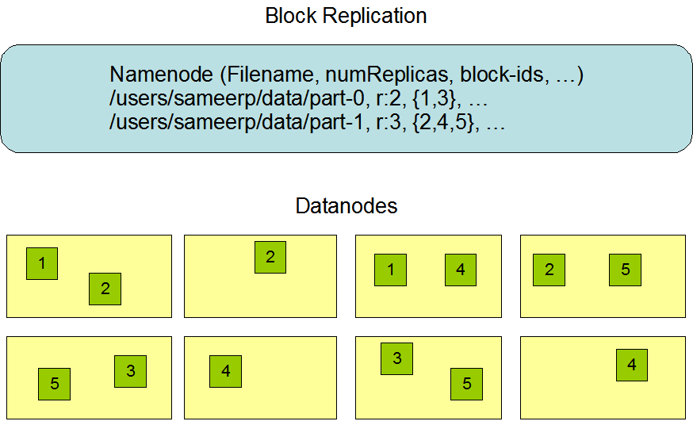
Hadoop Distributed File System (HDFS)
Centralized namenode
- Maintains metadata info about files
File F
1
2
3
4
5
Blocks (64 MB)
Many datanode (1000s)
- Store the actual data
- Files are divided into blocks
- Each block is replicated N times
(Default = 3)

Slide 95
Main Properties of HDFS
Large: A HDFS instance may consist of thousands of server machines, each storing part of the file system’s data
Replication: Each data block is replicated many times (default is 3)
Failure: Failure is the norm rather than exception
Fault Tolerance: Detection of faults and quick, automatic recovery from them is a core architectural goal of HDFS
Namenode is consistently checking Datanodes

Slide 96
Big Data Analytics and Mining
Junming Shao

Slide 97
Map-Reduce Execution Engine (Example: Color Count)
Input blocks on HDFS
Produces (k, v)
( , 1)
Shuffle & Sorting based on k
Consumes(k, [v])
( , [1,1,1,1,1,1..])
Produces(k’, v’)
( , 100)
Users only provide the “Map” and “Reduce” functions

Slide 98
Key-Value Pairs
Mappers and Reducers are users’ code (provided functions)
Just need to obey the Key-Value pairs interface
Mappers:
Consume <key, value> pairs
Produce <key, value> pairs
Reducers:
Consume <key, <list of values>>
Produce <key, value>
Shuffling and Sorting:
Hidden phase between mappers and reducers
Groups all similar keys from all mappers, sorts and passes them to a certain reducer in the form of <key, <list of values>>

Slide 99
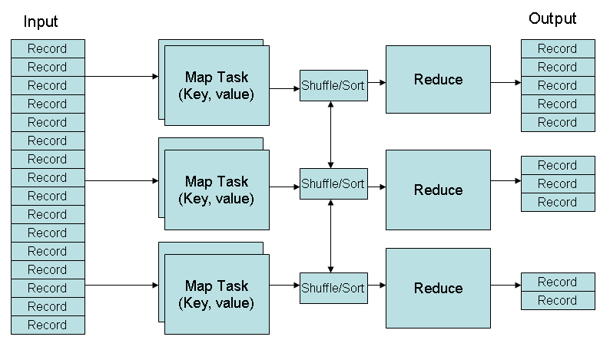
MapReduce Phases
Deciding on what will be the key and what will be the value ➔ developer’s responsibility

Slide 100
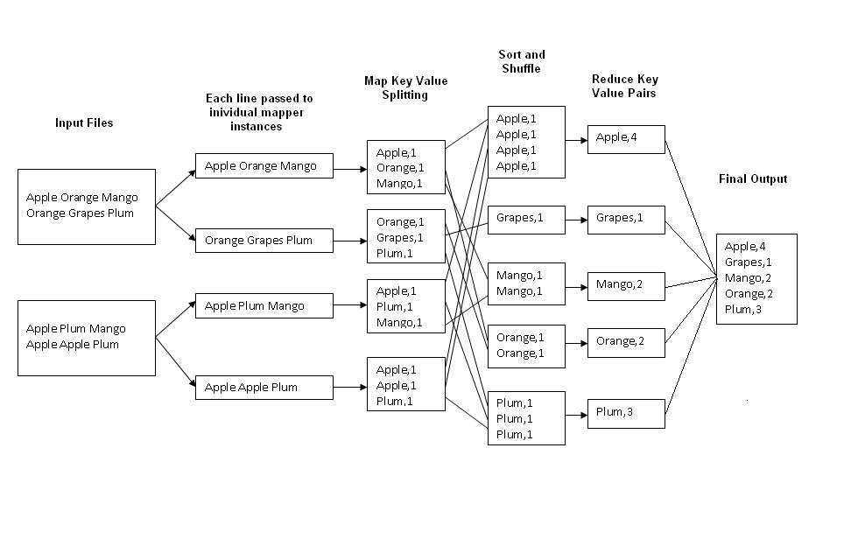
Example 1: Word Count
Job: Count the occurrences of each word in a data set
Map
Tasks
Reduce
Tasks

Slide 101
package wordsCount;
import java.io.IOException;
import java.util.StringTokenizer;
import org.apache.hadoop.io.IntWritable;
import org.apache.hadoop.io.LongWritable;
import org.apache.hadoop.io.Text;
import org.apache.hadoop.mapreduce.Mapper;
public class WordsMapper extends Mapper<LongWritable, Text, Text, IntWritable>{
@Override
protected void map(LongWritable key, Text value, Mapper<LongWritable, Text, Text, IntWritable> . Context context) throws IOException, InterruptedException {
String line = value.toString();
StringTokenizer st = new StringTokenizer(line);
while(st.hasMoreTokens()){
String word = st.nextToken();
context.write(new Text(word), new IntWritable(1));
}
}
}

Slide 102
package wordsCount;
import java.io.IOException;
import org.apache.hadoop.io.IntWritable;
import org.apache.hadoop.io.Text;
import org.apache.hadoop.mapreduce.Reducer;
public class WordsReduce extends Reducer<Text, IntWritable, Text, IntWritable>{
@Override
protected void reduce(Text key, Iterable<IntWritable> iterator,
Reducer<Text, IntWritable, Text, IntWritable>.Context context) throws IOException, InterruptedException {
// TODO 自动生成的方法存根
int sum = 0;
for(IntWritable i:iterator){
sum = sum + i.get();
}
context.write(key, new IntWritable(sum));
}
}

Slide 103
package wordsCount;
import org.apache.hadoop.conf.Configuration;
import org.apache.hadoop.fs.Path;
import org.apache.hadoop.io.IntWritable;
import org.apache.hadoop.io.Text;
import org.apache.hadoop.mapreduce.Job;
import org.apache.hadoop.mapreduce.lib.input.FileInputFormat;
import org.apache.hadoop.mapreduce.lib.input.TextInputFormat;
import org.apache.hadoop.mapreduce.lib.output.FileOutputFormat;
import org.apache.hadoop.mapreduce.lib.output.TextOutputFormat;
public class Run {
public static void main(String[] args) throws Exception{
// TODO 自动生成的方法存根
Configuration configuration = new Configuration();
Job job = new Job(configuration);
job.setJarByClass(Run.class);
job.setJobName("words count!");

Slide 104
job.setOutputKeyClass(Text.class);
job.setOutputValueClass(IntWritable.class);
job.setInputFormatClass(TextInputFormat.class);
job.setOutputFormatClass(TextOutputFormat.class);
job.setMapperClass(WordsMapper.class);
job.setReducerClass(WordsReduce.class);
FileInputFormat.addInputPath(job, new Path("hdfs://192.168.1.111:9000/user/input/wc/"));
FileOutputFormat.setOutputPath(job,new Path("hdfs://192.168.1.111:9000/user/result/"));
job.waitForCompletion(true);
}
}

Slide 105
MapReduce – KMeans
KmeansIter()
Map(p) // Assign Cluster
For c in clusters:
If dist(p,c)<minDist, then minC=c, minDist = dist(p,c)
Emit(minC.id, (p, 1))
Reduce() //Update Centroids
For all values (p, c) :
total += p; count += c;
Emit(key, (total, count))
Map1
Map2
Initial centroids

Slide 106
MapReduce – KMeans
KmeansIter()
Map(p) // Assign Cluster
For c in clusters:
If dist(p,c)<minDist, then minC=c, minDist = dist(p,c)
Emit(minC.id, (p, 1))
Reduce() //Update Centroids
For all values (p, c) :
total += p; count += c;
Emit(key, (total, count))
Map: assign each p to closest centroids
1
3
Reduce: update each centroid with its new location (total, count)
2
4
Map1
Map2
Initial centroids
Reduce1
Reduce2

Slide 107
MapReduce kNN
K=3
Map()
Input:
All points
query point p
Output: k nearest neighbors (local)
Emit the k closest points to p
1
0
1
1
1
0
1
0
1
1
1
0
0
0
0
1
0
Reduce()
Input:
Key: null; values: local neighbors
query point p
Output: k nearest neighbors (global)
Emit the k closest points to p among all local neighbors
Map1
Map2
Query point
Reduce

Slide 108
Summary
Big-Data is everywhere, we are just not used to deal with it
The “Big-Data” hype is very recent
Can we do “Big-Data” without big investment?
…yes – many open source tools, computing machinery is cheap (to buy or to rent)
…the key is knowledge on how to deal with data
…data is either free (e.g. Wikipedia) or to buy (e.g. twitter)

Slide 109
SPARK

Slide 110
Limitations of MapReduce
MapReduce is great at one-pass computation, but inefficient for multi-pass algorithms
No efficient primitives for data sharing » State between steps goes to distributed file system » Slow due to replication & disk storage

Slide 111
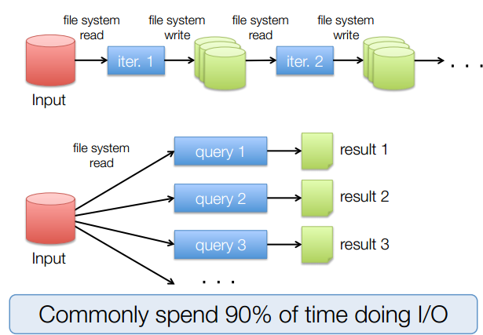
Example: Iterative Apps

Slide 112
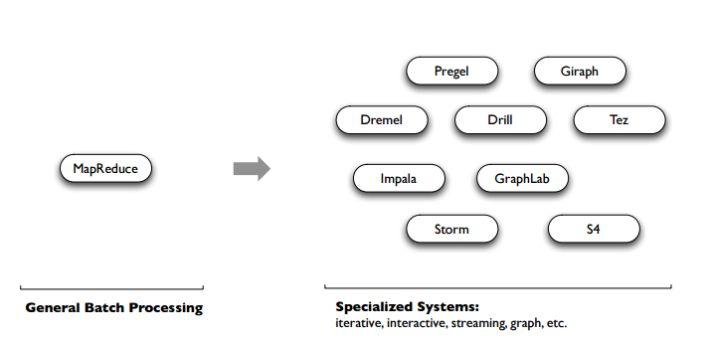
Spark
Unlike the various specialized systems, Spark’s goal was to generalize MapReduce to support new apps within same engine. This allows for an approach which is more efficient for the engine, and much simpler for the end users
Notes:
Mention that first there was a general batch system for all big data processing (MapReduce)
Then recently came the short period of specialized systems, but they were quite complicated and different from each other to learn
Spark is trying to unify the most popular processing paradigms

Slide 113


Motivation
(2007 – 2015?)
(2004 – 2013)
Giraph
(2014 – ?)
Pregel
Tez
Drill
Dremel
Mahout
Storm
S4
Impala
GraphLab
General Batch Processing
General Unified Engine
Specialized Systems
(iterative, interactive, ML, streaming, graph, SQL, etc)

Slide 114
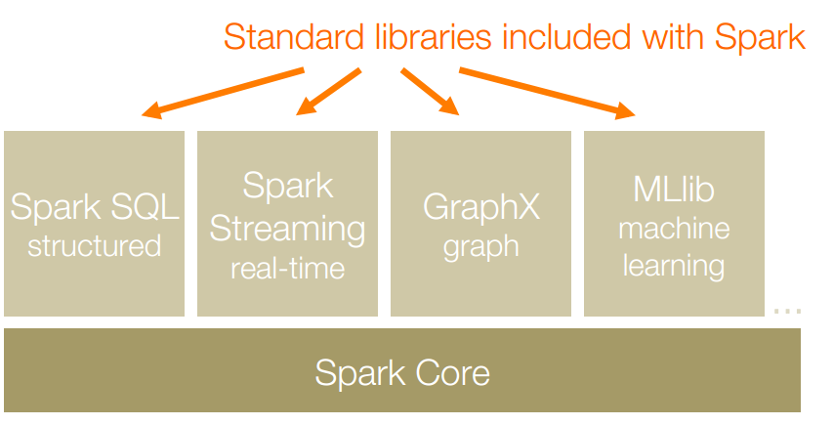
Apache Spark is a fast and general-purpose cluster computing system. It also supports a rich set of higher-level tools including Spark SQL for SQL and structured data processing, MLlib for machine learning, GraphX for graph processing, and Spark Streaming for streaming processing.

Slide 115
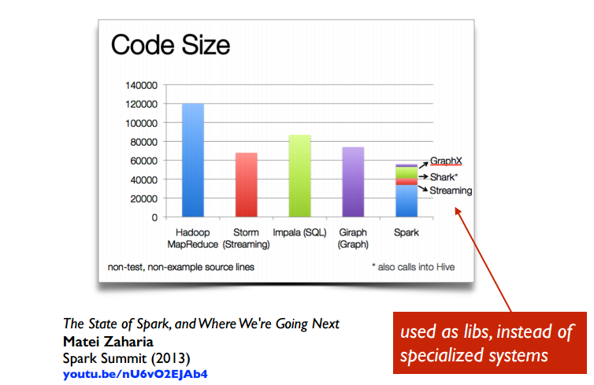

Slide 116
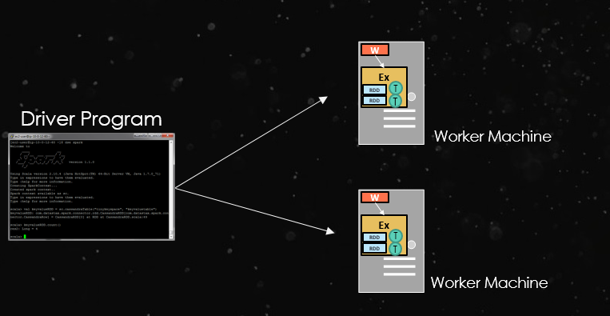
Basic Concept
At a high level, every Spark application consists of
a driver program that runs the user’s main function and
executes various parallel operationson a cluster.

Slide 117
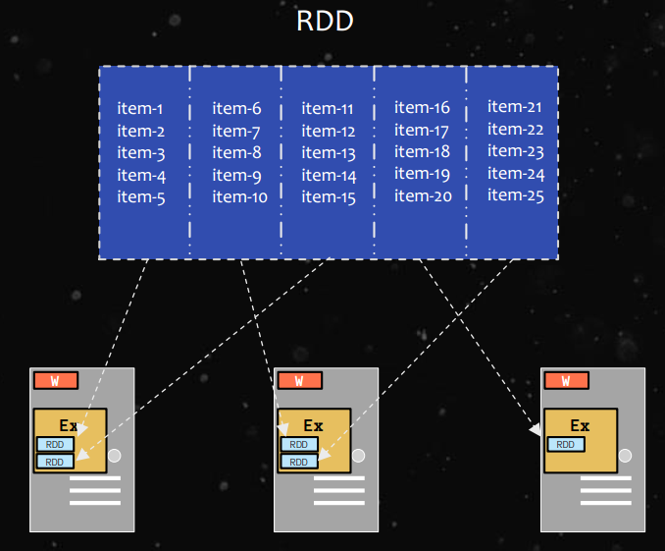
Basic Concept
The main abstraction in Spark is that of a resilient distributed dataset (RDD), which represents a read-only collection of objects partitioned across a set of machines that can be rebuilt if a partition is lost.

Slide 118
Creation of RDD
An RDD can be created 2 ways:
Parallelize a collection
Read data from an external source (S3, C*, HDFS, etc)
// Parallelize in Scala
val wordsRDD= sc.parallelize(List("fish", "cats", "dogs"))
//read data from an external source: val lines = sc.textFile(...)

Slide 119
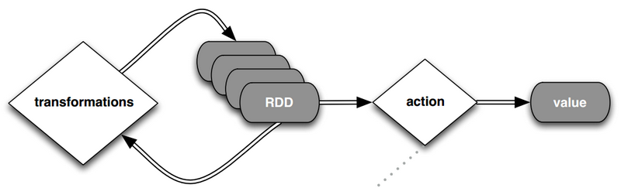
Operations on RDD
RDDs support two types of operations: transformations, which create a new dataset from an existing one, and actions, which return a value to the driver program after running a computation on the dataset.

Slide 120
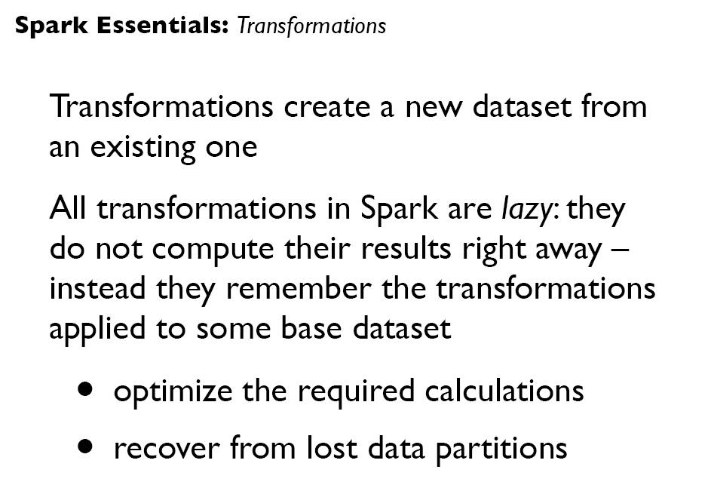

Slide 121
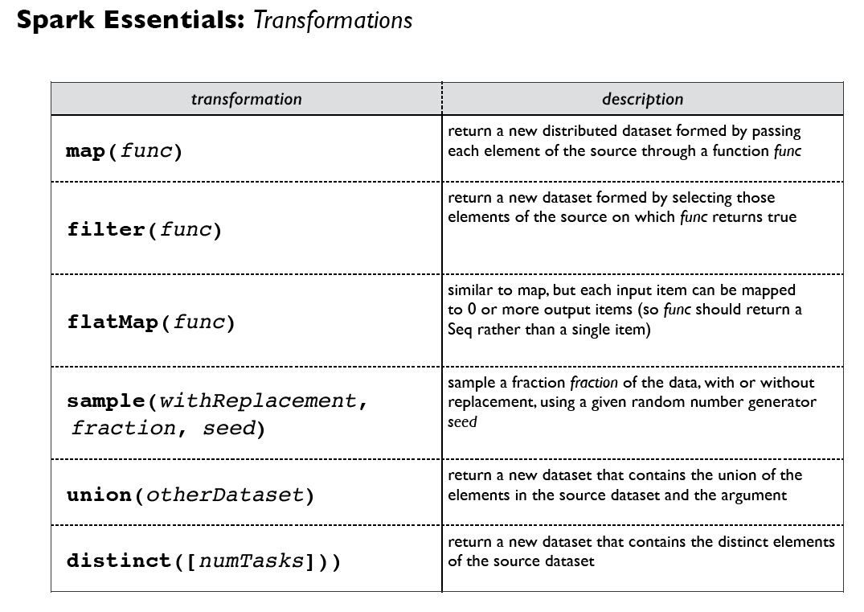

Slide 122
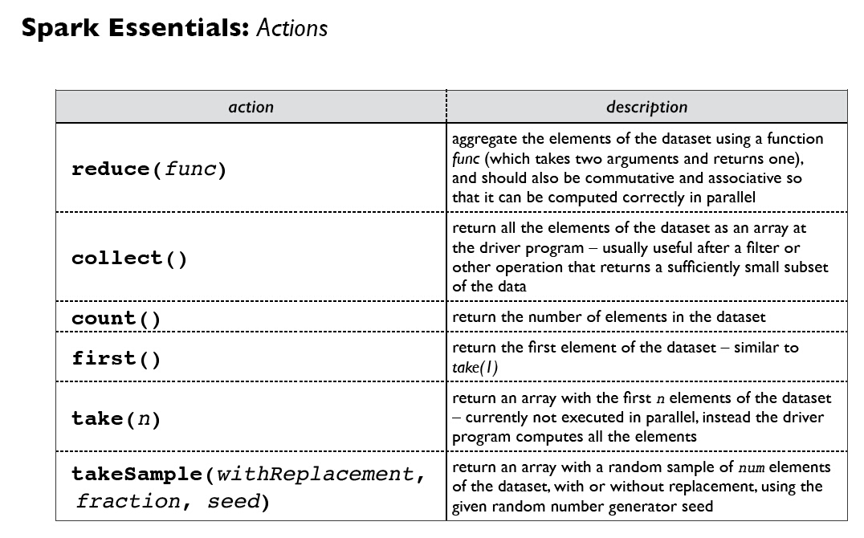

Slide 123
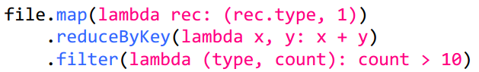
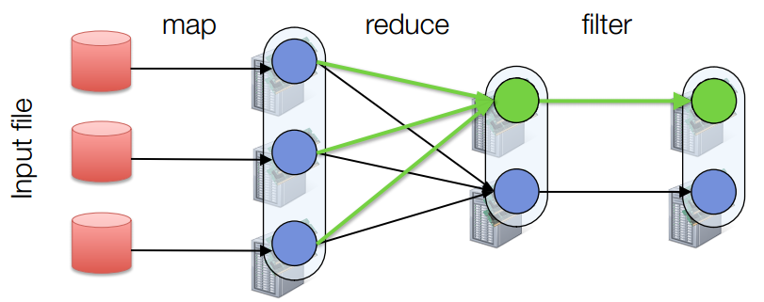
Fault Tolerance
RDDs track lineage info to rebuild lost data

Slide 124
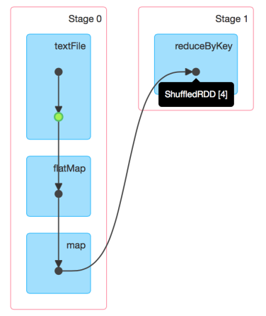
DAG of Word Count
Stage Graph
Needs to compute my parents, parents, parents, etc all the way back to an RDD with no dependencies .
Hadoop RDD
FilterMap RDD
Map RDD
Automatically rebuilt on failure

Slide 125
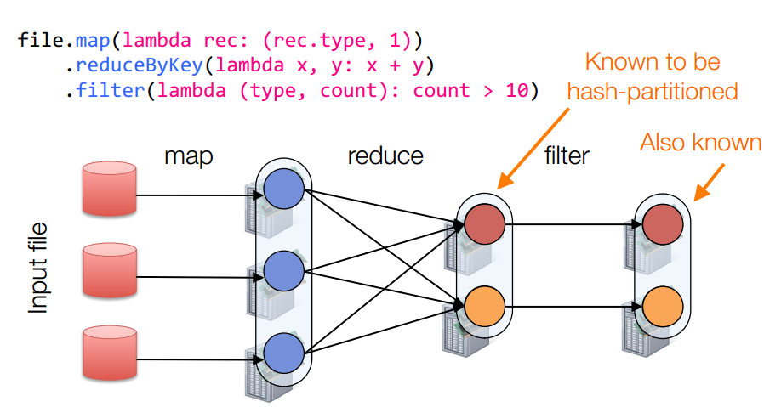
Partitioning
RDDs know their partitioning functions

Slide 126
Word Count of Spark
val lines = sc.textFile(“hamlet.txt”)
val counts = lines.flatMap( line=> line.split(“ ”)) .map(word => (word, 1)) .reduceByKey((x,y)=> x + y).collect()
textFile
flatMap
map
reducebyKey
“to” “be” “or”
(to, 1) (be, 1) (or, 1)
(be, 2) (not, 1)
(be, 2) (not, 1)
“to be or”
(or, 1)
(to, 2)
“not” “to” “be”
(not, 1) (to, 1) (be, 1)
(or, 1)
(to, 2)
“not to be”
Partition
RDD

Slide 127
MapReduce VS Spark
MapReduce
Great at one-pass computation, but inefficient for multi-pass algorithms.
No efficient primitives for data sharing.
Spark
Extends a programming language with a distributed collection data-structure（RDD）.
Clean APIs in Java, Scala, Python, R.

Slide 128
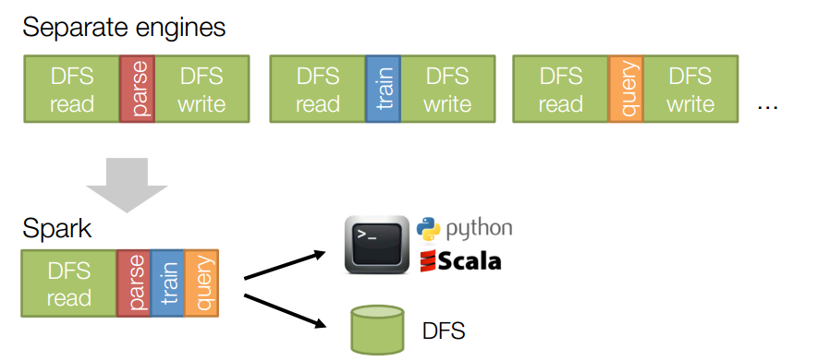
MapReduce VS Spark
Same engine performs data extraction, model training and interactive queries

Slide 129
Thanks !!!

